Slide 1

Software Construction and Development
Design Documentation
Dr. Malik Daler Ali Awan
1/10

Slide 2
A Quick Glance on Diagram list
Flowchart
Context Diagram
System Diagram
Data Flow Diagram
Entity Relationship Diagram
Sequence Diagram
Use Case Diagram
Activity Diagram
Class Diagram
2/10

Slide 3
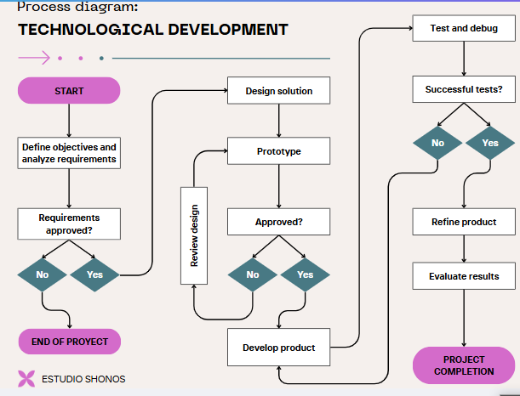
Flowchart
Purpose: A flowchart visually represents the logic of a process, showing different steps with arrows connecting them.
Use Case: Used in algorithm design, process modeling, and decision-making structures.
Symbol | Meaning
🟩 Terminator (Start/End) | Oval shape for Start/End points.
⬜ Process | Rectangle for actions or calculations.
🔷 Decision | Diamond shape for yes/no conditions.
🔄 Arrows | Show the flow of control.
3/10

Slide 4
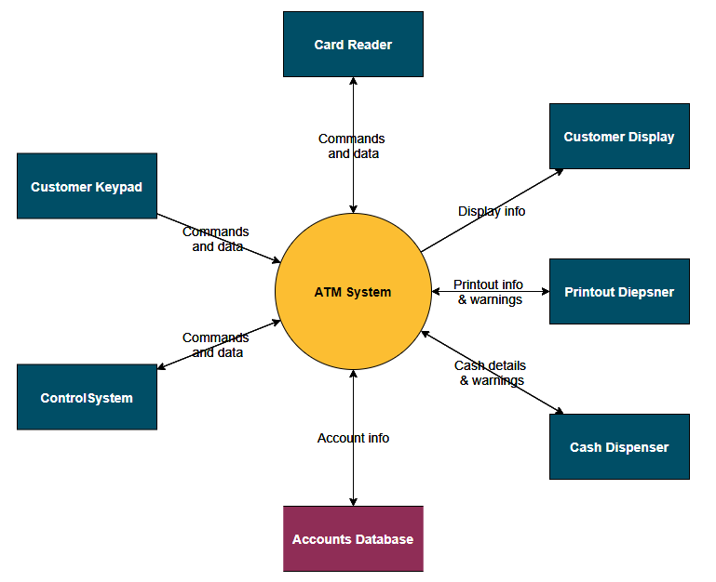
Context Diagram
Purpose: Shows the entire system as a single process and how external entities (users, other systems) interact with it. Use Case: Helps define system scope and boundaries before breaking it into smaller components.
4/10

Slide 5
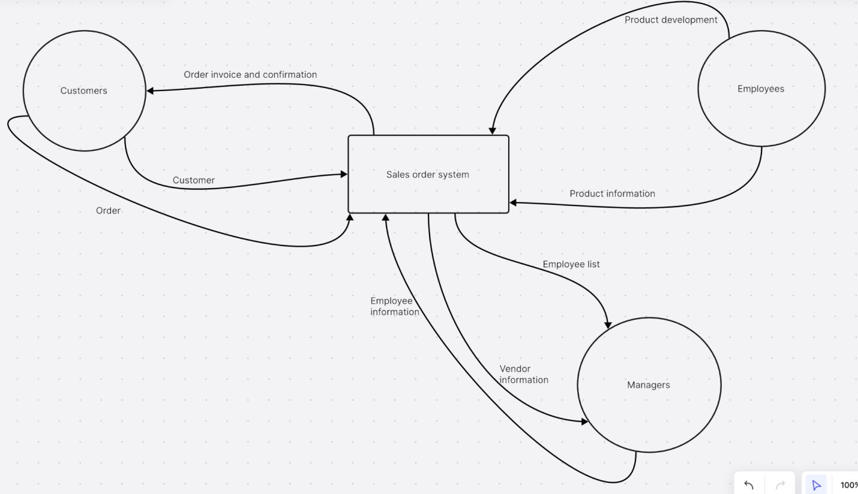
System Diagram
Purpose: Represents the major components of a system and their relationships.
Use Case: Used to plan high-level software architecture. Example: E-Commerce System Diagram Components: Frontend (Website/App), Backend, Payment Gateway, Database
Arrows: Show interaction & data flow.
5/10

Slide 6
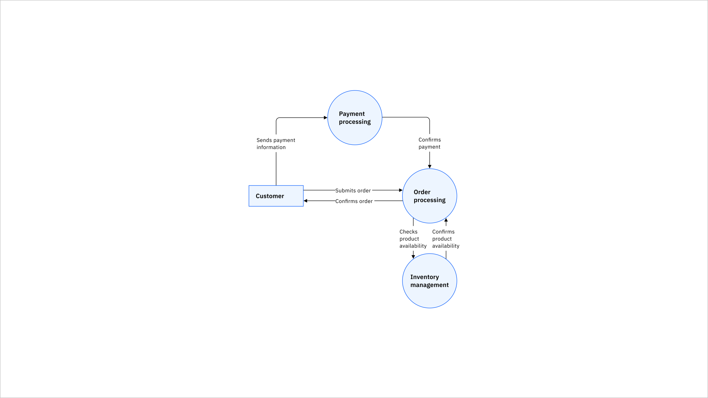
Data Flow Diagram DFD
6/10

Slide 7
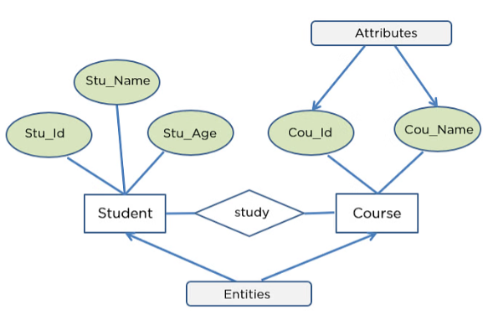
ER Diagram
Purpose: Defines how database entities relate to each other. Use Case: Used in database design before actual implementation.
Symbol | Meaning
🟦 Entity | Table or object (e.g., User, Order)
🔗 Relationship | Links between entities (e.g., Places Order)
🔶 Attributes | Properties of an entity (e.g., Name, Email)
7/10

Slide 8
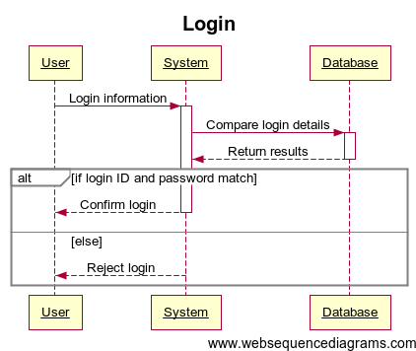
Sequence Diagram
8/10

Slide 9
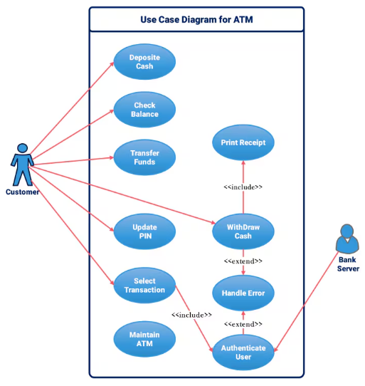
Use Case Diagram
9/10

Slide 10
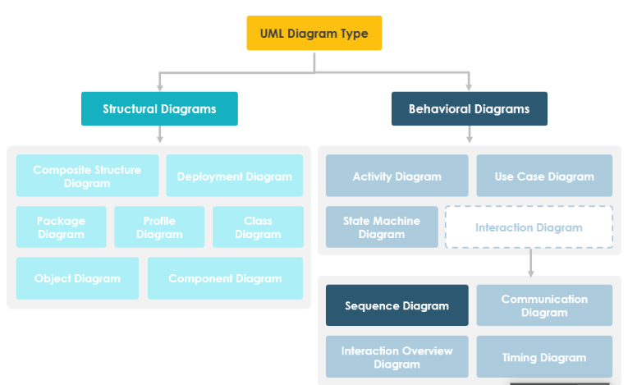
UML Diagram
10/10

